Slide 1
Chemistry 11
Unit 3
The Physical Properties
and Physical Changes of Substances

Slide 2
GOALS
definitions of matter
Identify physical vs chemical properties and changes
Physical properties: intrinsic vs extrinsic
Pure substances vs mixtures
How to separate mixtures

Slide 3
The Physical Properties of Matter
Matter:
  Anything that has mass and occupies space
  If it is not matter it is ENERGY
  Pure Substance: rare
    Only one type of element / compound
  Mixture: most things in the world
    Two or more types of substances

Slide 4
Pure Substances
Atom
  The smallest possible unit of an element which retains the fundamental properties of the element
Element
  A substance which cannot be separated into simpler substance as a result of any CHEMICAL process
  Only 1 type of atoms present
Ions
  Charged elements ready for bonding (cations & anions)
Molecule
  a cluster of 2 or more atoms held together strongly by electrical forces
Compound
  A pure substance made of more than 1 type of atom
  Only one type of molecule is a compound

Slide 5
What is an ion?
A positively or negatively charged element
Anions (Cl⁻) and cations (Na+)
Polyatomic ions are charged compounds (OH⁻)

Slide 6
Atom | Elements - Li
Charged elements Molecules Charged molecules | Ions Li⁺¹ Compounds NH_{3/} O₂ Ionic compounds NH₄⁺/ O²⁻

Slide 7
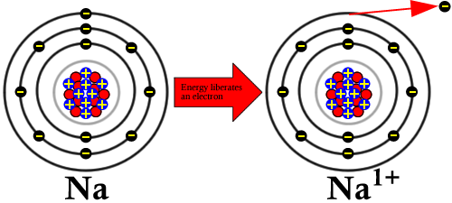
Ion:
*the number of electrons changes
* NEVER # of protons or neutrons
* to become more stable (a full outer shell). https://www.youtube.com/watch?v=Bfg9pq3Whmw

Slide 8
What is the charge of the ion?
Atom | Change in electrons | Ion charge
Al | Lost 3 | +3
O | Gained 2 | -2
Cu | Lost 1 | +1
Br | Gained 1 | -1
P | Gained 3 | -3

Slide 9
Mixtures
Anything that has two or more separate pure substances in the same space
  Cereal
  Seawater
  Jewelery alloy/ gold ore
  air

Slide 10
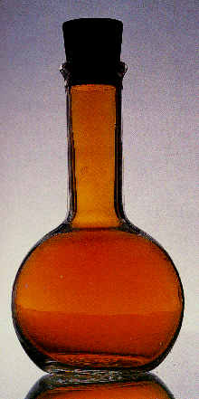
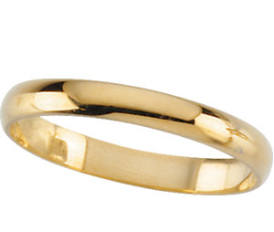
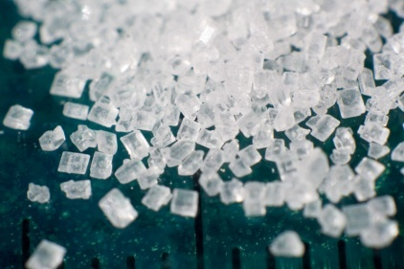
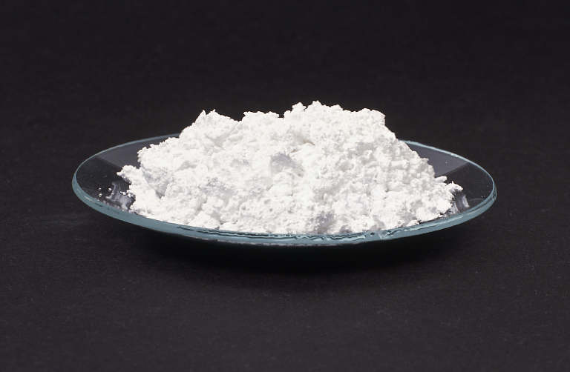
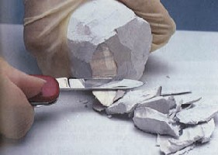
mixtures
Homogeneous: uniform all the way through
  Pure Substances are all homogenous: pure gold, distilled water, pure salt
  Mixtures in solution are homogenous:

Slide 11
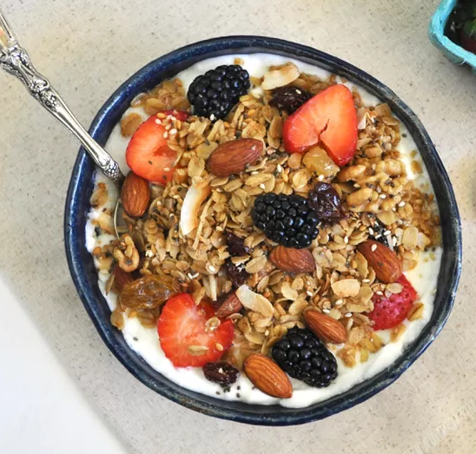
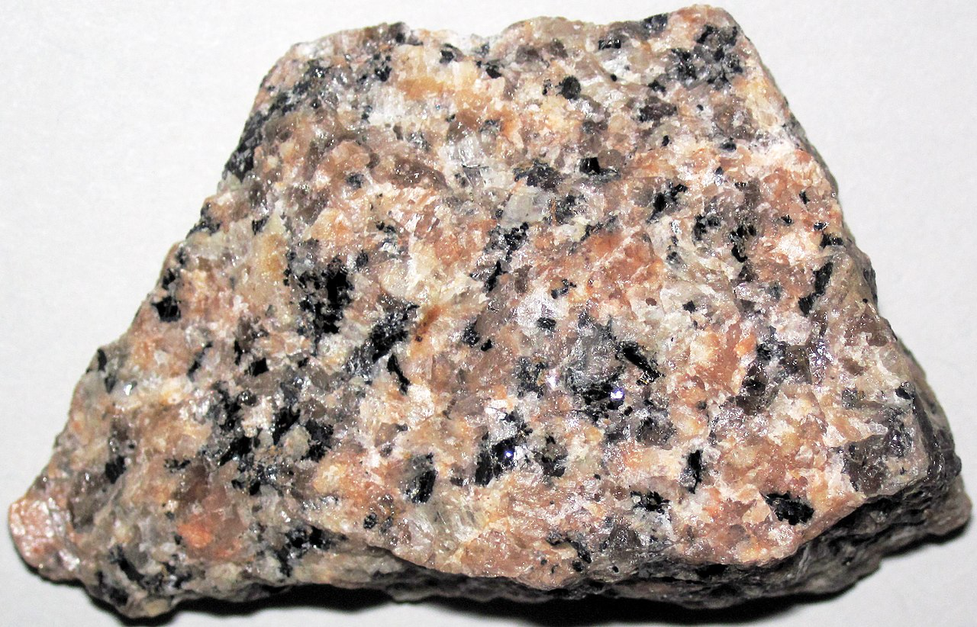
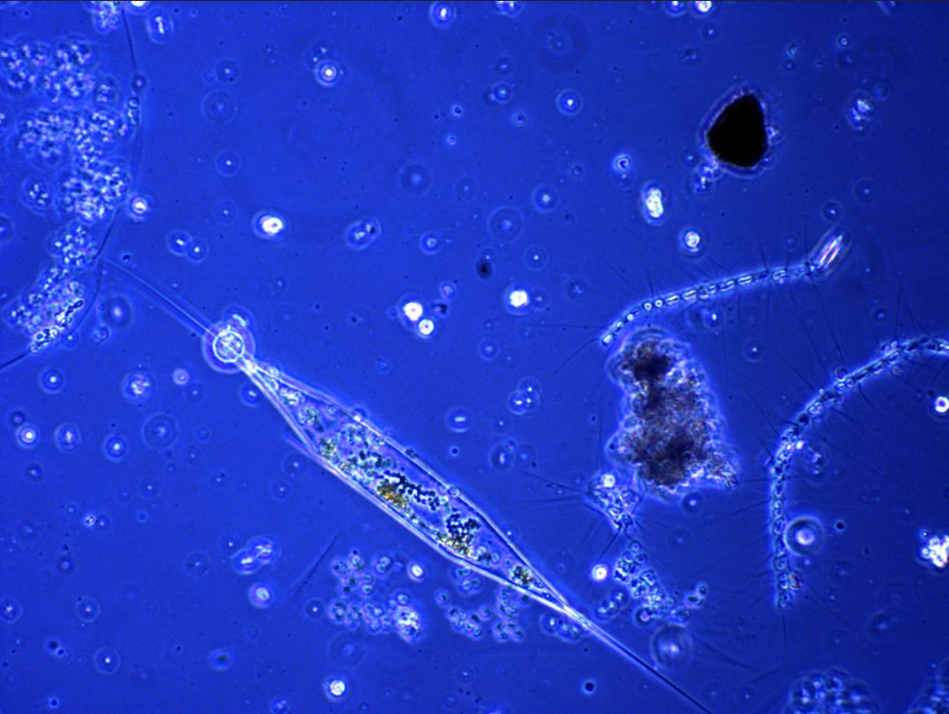
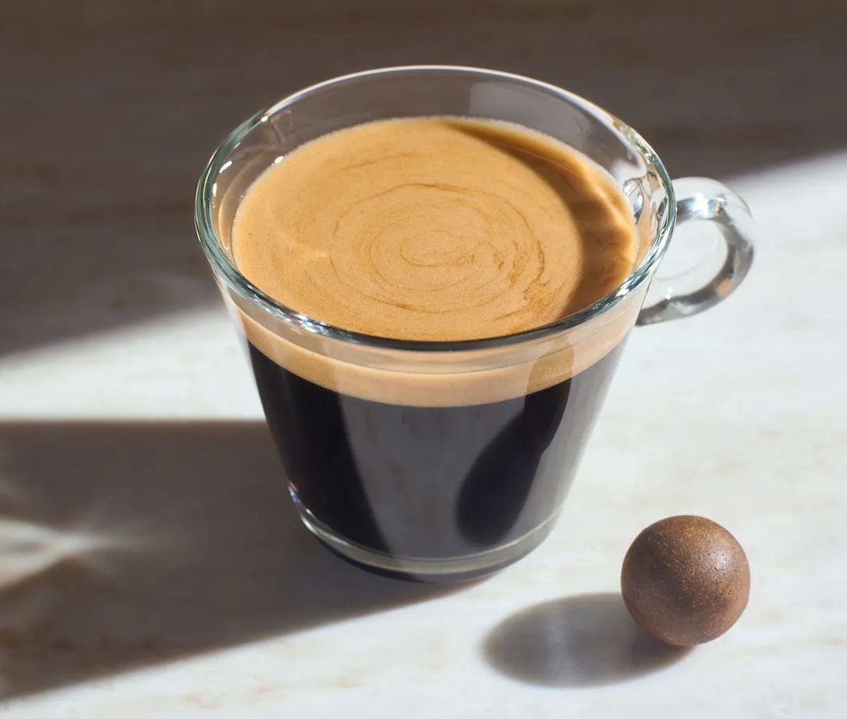
mixtures
Heterogeneous: not uniform all the way through
  No pure substances are heterogenous
  Mixtures not dissolved in a solvent
  Mechanical mixtures : easily observed separate parts: granite, granola
  Suspensions: coffee, tea, sea water, air

Slide 12
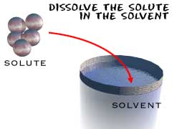
solvent
Aqueous (solvent is water= universal slvent)
Solvent (does the dissolving/is in greater quantity)
Solute (is dissolved/exist as the smaller quantity)
Precipitate (solid that forms at the bottom of a solution during a chemical reaction)

Slide 13
Classification of Substances
All MATTER
Homogeneous
Substances
Pure Substance
Element
(1 type of atom present)
Compound
(More then 1 type of
atom present)
Homogeneous
Mixture
Solution
Heterogeneous
Substances
Mechanical Mixtures

Slide 14
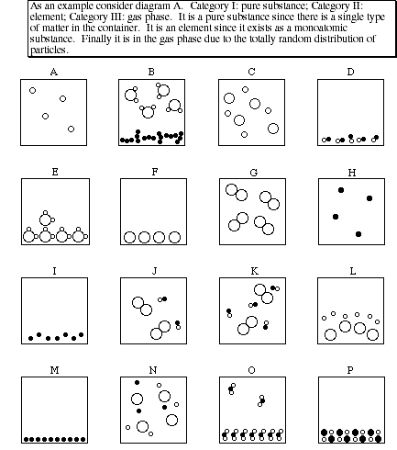
Classification of Substances
IDENTIFY:
Gasses
Liquids
Solids
Pure substances
elements
compounds
Mixtures
homogeneous
heterogeneous
Precipitates

Slide 15
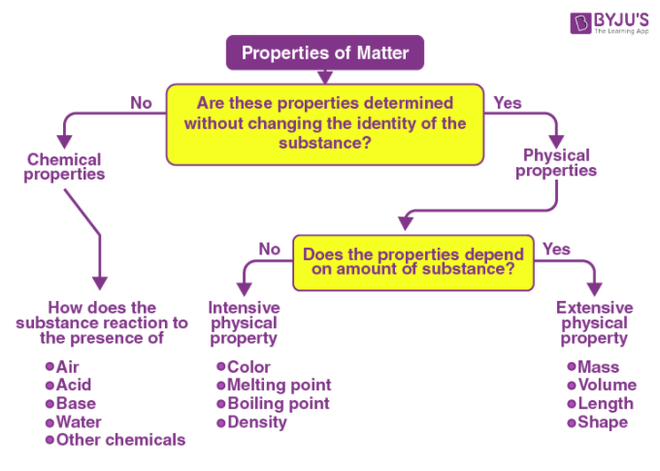

Slide 16
  PROPERTIES OF MATTER:
  Extensive Physical Property:
Can change with measurement: mass, volume length, duration, concentration, shape, phase
  Intensive Physical Property:
  Defines the substance: colour, smell, density, melting point/ BP, hardness, lustre, viscosity, malleability, ductility, solubility, etc…

Slide 17
INTENSIVE Physical properties:
Magnetism
  The ability to attract metals with a charged magnet
Hardness
  the ability to resist abrasion or scratching
Malleability
  the ability to be rolled or shaped into thin sheets
Ductility
  the ability to be stretched or drawn into wires
Lustre
  the manner in which a solid reflects light
  Terms include: metallic, adamantine, glassy, oily, pearly, silky or dull
Viscosity
  the resistance of a fluid to flow (low = fast, high = slow)
Diffusion
  the intermingling of fluids as a result of motion within the fluid (gases and liquids)
Colour, odor, texture, state (liquid, solid, gas)

Slide 18
States of Matter: phases
Solid liquid gas_________
denser > less dense > least dense
Kinetic energy < Kinetic energy < Kinetic energy
Shape shape of container shape of container
Volume volume volume of container
SPECIAL CASES
Plasma
  high temperature low pressure
  electrons separate from nucleus
  Most common in the universe
More at very low temp
  Bose- Einstein condensate
  Quantum superfluids

Slide 19
Condense
Freeze
Melt
Evaporate
Solid
Liquid
Gas

Slide 20
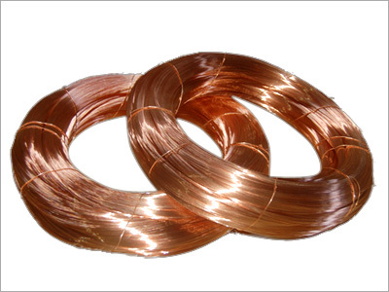
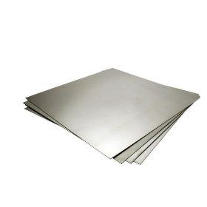
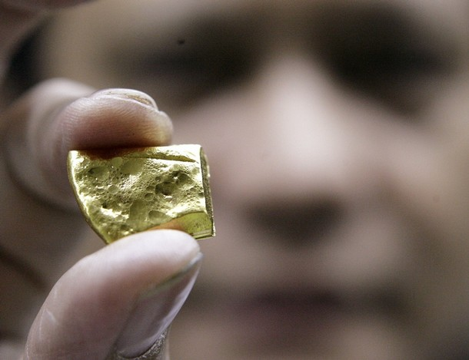
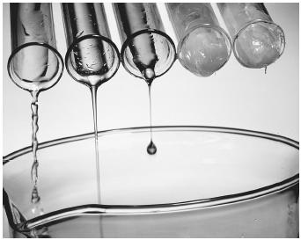
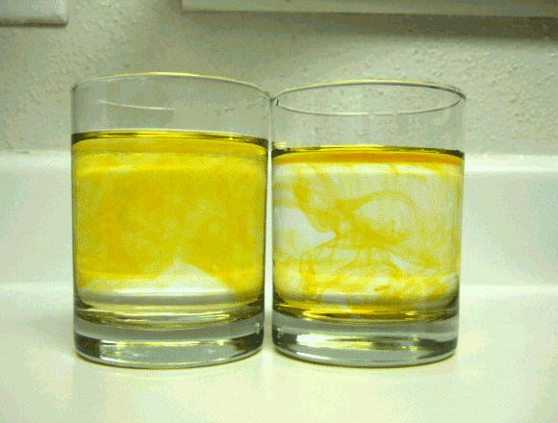
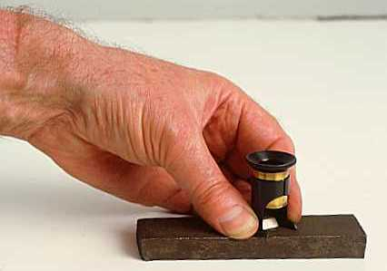
Ductile
Malleable
Lustre
Viscosity
Hardness
Diffusion

Slide 21
Examples | Intesive or Extensive?
Density
Colour
Smell
Melting point
Mass
Temperature
Volume
Solubility

Slide 22
Examples | Intesive or Extensive?
Density | I
Colour | I
Smell | I
Melting point | I
Mass | E
Temperature | E
Volume | E
Solubility | I

Slide 23
Identifying Chemical vs. Physical changes
Chemical Change
  When a new substance is formed
  Bubbles
  Colour change
  Texture change
  Energy / light change
Physical change
  No new substance is formed
  Shape change
  Phase change (liquid/ solid/ gas)

Slide 24
The Separation of Substances
CHOSE THE SEPARATION METHOD THAT IS THE EASIEST!!!

Slide 25
    Mechanical Mixtures
Mixture | Method | When to Use Method
Solid in Solid or liquid Ex. granola | Hand Separation | Large chunks present among other solids
 | Gravity Separation | The density of the desired solids is much different form the density of the other solids.
 | Filtration | Solid particles are present in a large amount of liquid.
 | Paper Chromatography | The solids are coloured, present in small amounts and are soluble in some solvent or mixture of solvents

Slide 26
    Mechanical Mixtures
Other: Cereal in milk | Magnet | Using a magnet to separate magnetic metals from other matter
 | Gravity Separation *centrifuge* | Solid particles are present in a small amount of liquid.
 | Solvent Extraction | One solid preferentially dissolves in a particular solvent.

Slide 27
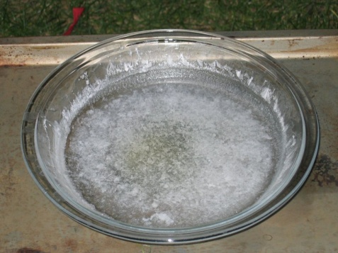
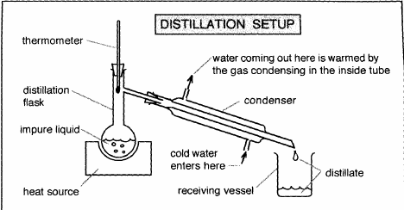
HOMOGENEOUS MIXTURES IN Solutions
Mixture | Method | When to Use Method
Solid in Liquid (Homogeneous) Chicken stock or alcohol | Evaporation | The solid is wanted and the liquid is not.
 | Distillation | The liquid is wanted; the solid may or may not be wanted.

Slide 28
Heterogeneous MIXTURES IN Solutions
Mixture | Method | When to Use Method
Oil and water/ lava lamp | Solvent Extraction | An immiscible added solvent preferentially dissolves at least one but not all the solids present.

Slide 29
HOMOGENEOUS MIXTURES IN Solutions
Mixture | Method | When to Use Method
Salt water Colour wheel | Recrystillization | One dissolved solid is much less soluble than the others present (if any); the liquid is not wanted.
 | Chromatography | Small amounts of the more than one coloured solid are present; the liquid present is not wanted.

Slide 30
RECALL Phase changes:
MELTING TEMPERATURE (MP)
  The temperature where solid changes to liquid
FREEZING TEMPERATURE (FP)
  The temperature where liquid changes to solid.
  At the MELTING/FREEZING TEMPERATURE, the solid and liquid phases co-exist.
BOILING TEMPERATURE (BP)
  The temperature where liquid changes to gas.
CONDENSATION TEMPERATURE (CP)
  The temperature where gas changes to liquid.
  At the BOILING/CONDENSATION TEMPERATURE, the liquid and gas phases co-exist.
NOTE: The temperature does not change during a phase change (such as melting and boiling).

Slide 31
Continued heating of a pure solid substance produces the following temperature behavior

Slide 32
There is a steady decrease in the amount of solid as the amount of liquid increases. At the start of the phase change the substance is 100% solid, then more and more liquid forms. Eventually, the last bit of solid melts and the phase change is complete as shown by the graph below:

