Slide 1
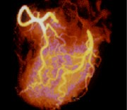
Getting to the Heart of the Matter
Human Anatomy & Physiology
Cardiovascular System

Slide 2
Notes:
In the 15th and 16th centuries, alchemists & herbalists which were the doctors of the time, often referenced a belief system called the “Doctrine of Signatures” which in basic terms meant that if a plant was created with the shape of a human organ (heart shaped for example) or held powers like strong chili peppers similar to the power of the heart, it was the plant’s “signature” or way of letting humankind know that it was meant to cure the organ it resembled. For example, heart shaped leaves or flowers would cure ailments of the heart. It came from a philosophy shared by herbalists from the times if Ancient Greece and Rome. This idea is still found among common plant names. It has no scientific or medical basis.

Slide 3
Notes:
These are examples of plants that might be used to treat heart ailments at that time in history. Today, we know that there is no scientific evidence that these plants would be helpful in treating heart ailments, in fact a few may cause illness or death.

Slide 4
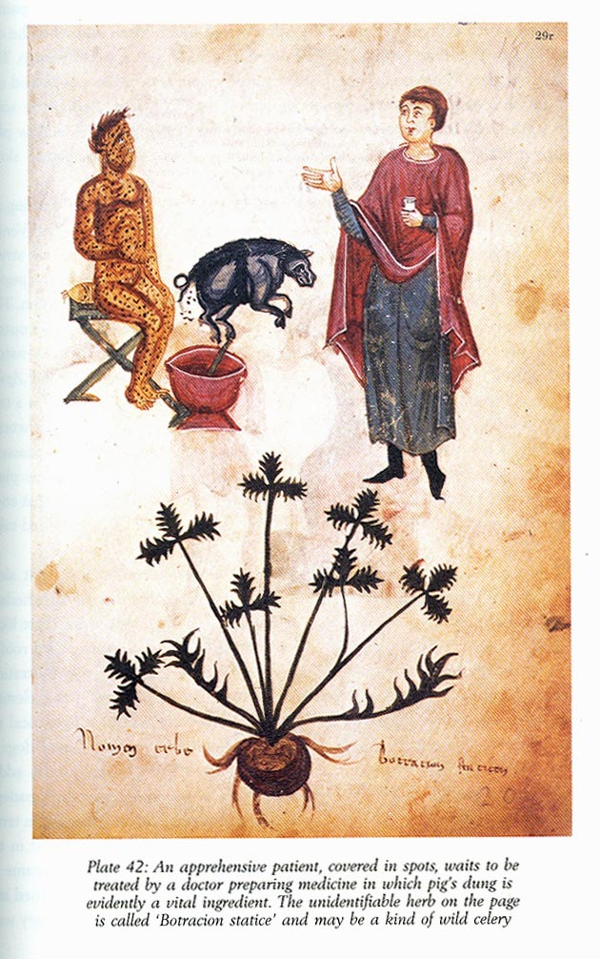
Doctrine of Signatures~Physician
Diagnosis: spots
Treatment Plan:
Pig dung
Celery-like plant
Notes:
This poor patient has been diagnosed with “Spots” on his skin. The kind alchemist prescribes a wild celery – like plant and pig dung for treatment. I would scream too! Today we know these may make the rash infected or aggravated, certainly not cure it. Remember, in the 15th and 16th centuries, science and medicine did not possess the technology that we have today to help diagnose or discover what is actually wrong with a patient.

Slide 5
Notes:
Ask students if they can you name some of the tools used today that physicians use to find out what is going on with a Heart Patient? (Diagnostic Equipment). Answers should include ECG, Stethoscope, X-Ray, BP Monitor etc. Write on the board student responses as they think of them. Ask them what each one does before revealing the list above. If you have examples of X-rays, an ECG or any of these it is helpful in sharing with students how physicians may use them for identifying and diagnosing diseases or problems.

Slide 6
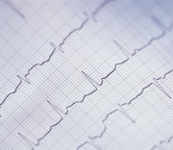
Modern Medicine
Diagnostic tools for cardiac assessment?
EKG/ECG
Stethoscope
BP monitor
O₂ Oximeter
MRI
MPI Radionuclide
Echocardiograms
Blood work
X-Ray
Angiogram
Ultrasound
Halter Monitor
ZIO® Patch
Notes:
Ask students if they can you name some of the tools used today that physicians use to find out what is going on with a Heart Patient? (Diagnostic Equipment). Answers should include ECG, Stethoscope, X-Ray, BP Monitor etc. Write on the board student responses as they think of them. Ask them what each one does before revealing the list above. If you have examples of X-rays, an ECG or any of these it is helpful in sharing with students how physicians may use them for identifying and diagnosing diseases or problems.

Slide 7
Notes:
These are basic facts about the structure and function of a healthy heart. The conduction system may be the only one that needs additional elaboration. This tissue is specialized to conduct an electrical signal that keeps the heart beating and at the rate needed to keep the body and every living cell oxygenated, and to carry away the waste such as CO₂.
Note:
In order for the heart to pump efficiently, the individual myocardial fibers must contract and relax in a coordinated, rhythmic fashion. This characteristic of the healthy heartbeat is called synchrony. Synchrony is maintained by the heart's own intrinsic electrical system, which originates and transmits electrical impulses through a specialized conduction pathway. Just as the pulse is evidence of the heart's mechanical activity, the electrocardiogram or ECG, is evidence of its electrical activity (source: http://nuclearcardiologyseminars.net/electrophysiology/conduction accessed 2020)

Slide 8
Notes:
These are basic facts about the structure and function of a healthy heart. The conduction system may be the only one that needs additional elaboration. This tissue is specialized to conduct an electrical signal that keeps the heart beating and at the rate needed to keep the body and every living cell oxygenated, and to carry away the waste such as CO₂.
Note:
In order for the heart to pump efficiently, the individual myocardial fibers must contract and relax in a coordinated, rhythmic fashion. This characteristic of the healthy heartbeat is called synchrony. Synchrony is maintained by the heart's own intrinsic electrical system, which originates and transmits electrical impulses through a specialized conduction pathway. Just as the pulse is evidence of the heart's mechanical activity, the electrocardiogram or ECG, is evidence of its electrical activity (source: http://nuclearcardiologyseminars.net/electrophysiology/conduction accessed 2020)

Slide 9
Notes:
Using a heart model or creating a diagram here is useful for lab activities later.

Slide 10
Notes:
Have students individually, as teams or as a class explain what they think Blood Pressure is and what is being measured.
Note: Recent (2019-20) research has indicated that a person’s BP may change throughout a day. What is considered “normal range” may vary per individual. Answer: can the DP ever be greater/higher than the SP? It is impossible!

Slide 11
Notes:
Note: Recent (2019-20) research has indicated that a person’s BP may change throughout a day. What is considered “normal range” may vary per individual. Answer: can the DP ever be greater/higher than the SP? It is impossible!

Slide 12
Notes:
Students may need to know that they must count the number of beats per minute (or for 30 seconds then x 2); Capillary refill is pressing a finger nail, letting it blanche or turn pale, then releasing it—it should pink up quickly. This indicates the capillary blood vessels, the smallest vessels in our circulatory system, are functioning well. It is also a good teaching moment to connect that the oxygenated blood goes to EVERY living cell in the human body, even our finger tips. Also—there is no actual BLUE blood. Our venous blood has little to no oxygen in it. When blood lacks oxygen, it becomes dark as opposed to bright red with oxygen. The venous vessels also add to the “blue” appearance of the veins. If students have a diagram of the heart they can trace the route the blood takes, where it gets oxygen, and which chambers of the heart pump out to the body (L-Ventricle), and which pump to the lungs (R-ventricle).

Slide 13
Notes:
In this math extension be sure the students use the correct number of heart beats to calculate correctly the period of time (pulse rate x 60=1 hour, 1 hour x 24=1 day; 1 day x 365= 1 year); Otherwise the counts may come out incorrectly. Some calculators may not be able to get up to the higher calculations. To calculate respiratory rate (RR) count one entire breath in AND the exhalation of that breath = 1 respiration. I tell my students that while the nurse or doctor are taking their temperature, they are also counting their RR since if you know someone is watching, you may be self conscious and change your breathing. This may also happen for the activity but students can be instructed to take their own RR after sitting for a while as a “resting rate”.

Slide 14
Notes:
Have students individually, as teams or as a class deliver the structures and functions of both arteries and veins.
For a demonstration: search for YouTube clips that show a vein and artery; then link it into the PP.

Slide 15
Notes:
Check against student responses here.

Slide 16
Notes:
Have students individually, as teams or as a class deliver the structures and functions of both arteries and veins.
For a demonstration: search for YouTube clips that show a vein and artery; then link it into the PP.

Slide 17
Notes:
Check against student responses to previous slide here.
For a demonstration: search for YouTube clips that show a vein and artery; then link it into the PP.

Slide 18
Notes:
This is how bodies deliver oxygen and nutrients to every living cell in our bodies, and remove waste, including CO₂ out of our bodies.

Slide 19
Notes:
This is how bodies deliver oxygen and nutrients to every living cell in our bodies, and remove waste, including CO₂ out of our bodies.

Slide 20
Notes:
This is how bodies deliver oxygen and nutrients to every living cell in our bodies, and remove waste, including CO₂ out of our bodies.

Slide 21
Notes:
Blood is the only tissue that is both solid and liquid.

Slide 22
Notes:
Blood is the only tissue that is both solid and liquid.

Slide 23
Notes:
Blood is the only tissue that is both solid and liquid.

Slide 24
Notes:
Here are the details of how one heart beat occurs.

Slide 26
Notes:
This is basic CPR / first aid.

Slide 27
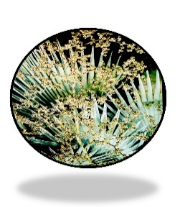
Thank you for downloading this cardiovascular system PowerPoint.
For the complete unit please see:
https://www.teacherspayteachers.com/Product/Cardiovascular-System-Unit-Heart-207623
Created by Science Rules!
Copyright © Science Rules! 2011-present
All rights reserved by author.
This document is for your classroom use only.
This document may not be electronically distributed, shared, or posted to a web site.
www.teacherspayteachers.com/Store/Science-Rules-37
Copyright © Science Rules 2012-Present

