Slide 1
Jeopardy
D.N.A.
Don’t kNow Anything
Fossil Finding in a time scale
Could You Spare Any CHANGE- Evolution That Is
DARWINIAN Stuff
UNIT I Miscellaneous
100
100
100
100
100
200
200
200
200
200
300
300
300
300
300
400
400
400
400
400
500
500
500
500
500
Final Jeopardy

Slide 2
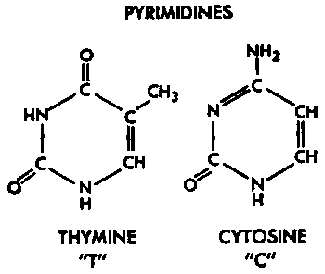
DNA-100
ANSWER: The base pair that would bond with cytosine
QUESTION: What is guanine?

Slide 3
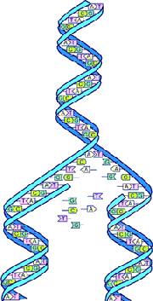
DNA-200
ANSWER: The process shown here
QUESTION: What is REPLICATION

Slide 4
DNA-300
ANSWER: The combination of a base, a phosphate group, and deoxyribose sugar
QUESTION: What is a nucleotide?

Slide 5
DNA-400
ANSWER: The complementary strand of DNA for the following sequence:
ATC CTC GTA
Will spell these three words.
QUESTION: What is TAG GAG CAT

Slide 6
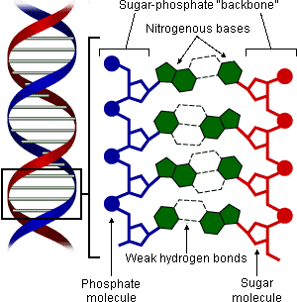
DNA-500
ANSWER: A triple – “Hydrogen Bond” forms between these two bases, give full names for each.
QUESTION: What are Cytosine and Guanine?

Slide 7
Fossil Finding-100
ANSWER: The layer that contains the youngest fossils
QUESTION: What is the top layer?

Slide 8
Fossil Finding-200
ANSWER: The area in BC that has a huge number of unique fossils.
QUESTION: What is the Burgess Shale?

Slide 9
Fossil Finding-300
ANSWER: The determination of an age of rock using isotopes.
QUESTION: What is radioactive dating?

Slide 10
Fossil Finding-400
ANSWER: 4.5 billion years.
QUESTION: How old is the Earth?

Slide 11
Fossil Finding-500
ANSWER: A radioactive isotope used to date “young” fossils?
QUESTION: What is Carbon-14?

Slide 12
Evolutionary Change-100
ANSWER: This is defined as the RANDOM change (by chance) to the allelic frequencies of a gene.
QUESTION: What is GENETIC DRIFT

Slide 13
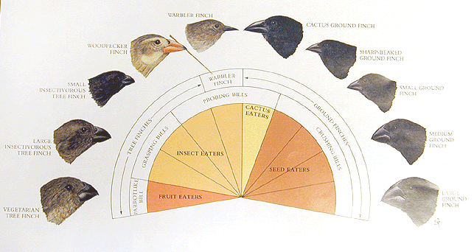
Evolutionary Change-200
ANSWER: When a single species evolves into many different species, this specific type of divergent evolution has occurred.
QUESTION: What is Adaptive Radiation

Slide 14
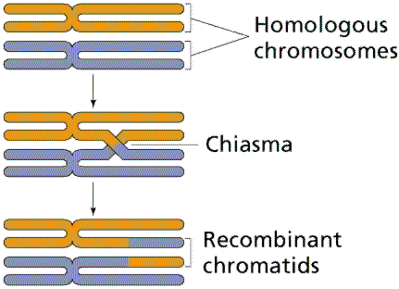
Evolutionary Change-300
ANSWER: This meiotic process results in the complete shuffling of genes which increases genetic variation.
QUESTION: What is CROSSING OVER?

Slide 15
Evolutionary Change-400
ANSWER: When nature favours an extreme characteristic
QUESTION: What is directional selection?

Slide 16
Evolutionary Change-500
ANSWER: These are 3 factors that can increase genetic variation
QUESTION: What are:
1. Mutations
2. Gene flow
3. Recombination

Slide 17
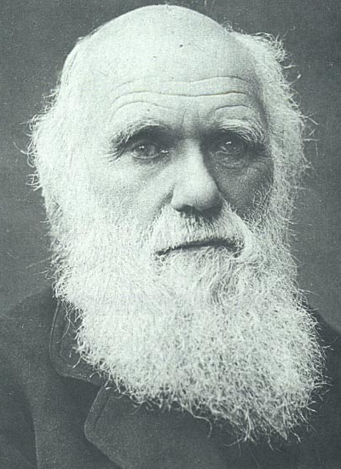
Darwinian-100
ANSWER: The selection of traits based on the current environment.
QUESTION: What are the Natural Selection?

Slide 18
Darwinian-200
ANSWER: Examples are Darwin’s finches, the Peppered moth, and Antibiotic Resistant bacteria
QUESTION: What is Natural Selection?

Slide 19
Darwinian-300
ANSWER: These are the three main categories of adaptations that plants, animals and other life forms possess.
QUESTION: What are :
1. Behavioural
2. Structural
3. Physiological

Slide 20
Darwinian-400
ANSWER: These are Darwin’s 5 ideas
QUESTION : What is:
Overpopulation
Competition
Variation
Survival of the Fittest
New Species

Slide 21
Darwinian-500
ANSWER: Individuals with advantageous genetic traits are better adapted to their environment
QUESTION: What is Survival of the Fittest?

Slide 22
Miscellaneous-100
ANSWER: A small strand of DNA that codes for a protein
QUESTION: What is a gene?

Slide 23
Miscellaneous-200
ANSWER: remnants of a structure that had a function but no longer does in the evolved organism.
QUESTION: What is a vestigial structure?

Slide 24
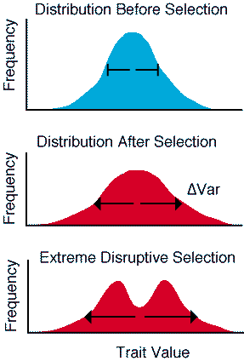
Miscellaneous-300
ANSWER: The type of selective pressure illustrated here. Going from top graph down to give rise to the bottom graph.
QUESTION: What is Disruptive Selection?

Slide 25
Miscellaneous-400
ANSWER: The main source of new alleles.
QUESTION: What is a mutation?

Slide 26
Miscellaneous-500
ANSWER: The type of evolutionary change shown in the diagram
Question: What is punctuated equilibrium?

Slide 27
FINAL JEOPARDY
QUESTION: List at least 5 strong bits of evidence that support the idea that things can and have evolved.
ANSWER:
1. Fossil Record
2. Embryological Comparisons.
3. Organism Preservation – in Tarpits, Amber & flash frozen
4. Comparative Anatomy
5. DNA

